Slide 1

Engaging Students in Zoom with Polls

Slide 2
Zoom features
Chat
Nonverbal feedback
Reactions
Polls
Annotations
Break-out rooms

Slide 3

Polls
Easy to set up
Easy to execute during class
  Gauge participation level
  Share anonymous responses
Easy for students to respond
Use before or after concept delivery

Slide 4

Polls – set up
Verify settings
Create poll questions
  Single choice
  Multiple choice

Slide 5
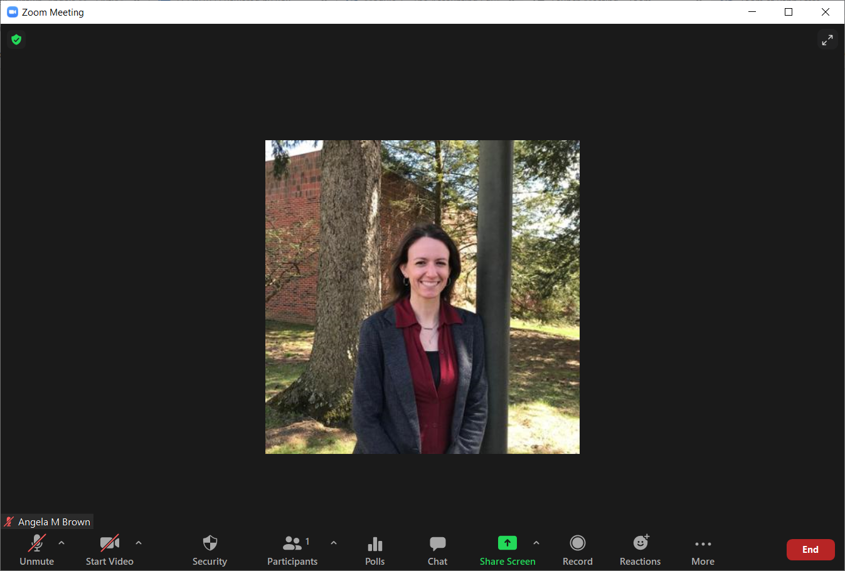
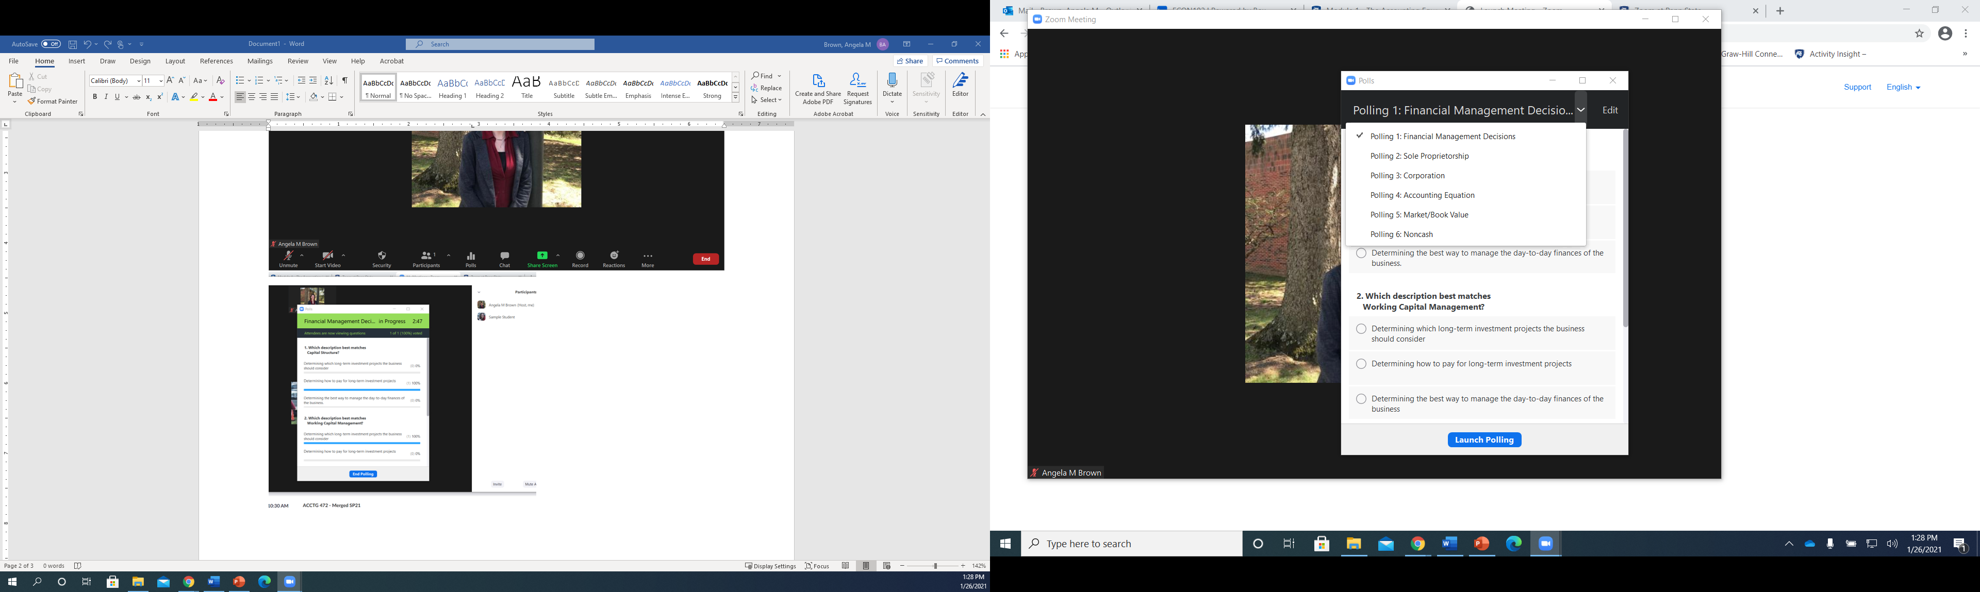
Polls - Execute
(1) Click “Polls” in your toolbar
(2) Choose your poll from the drop-down arrow

Slide 6
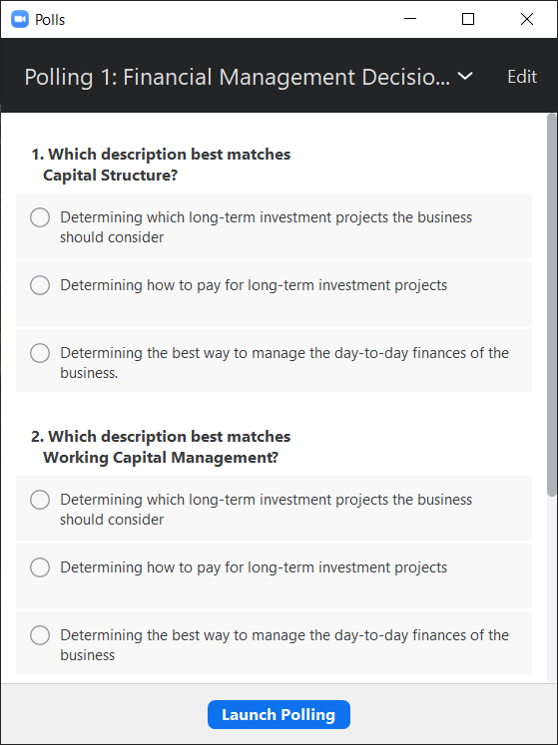
Polls - Execute
(3) Once you have selected the correct poll, “Launch” the poll. At this point the meeting participants will have the option to choose an answer(s) and submit.

Slide 7
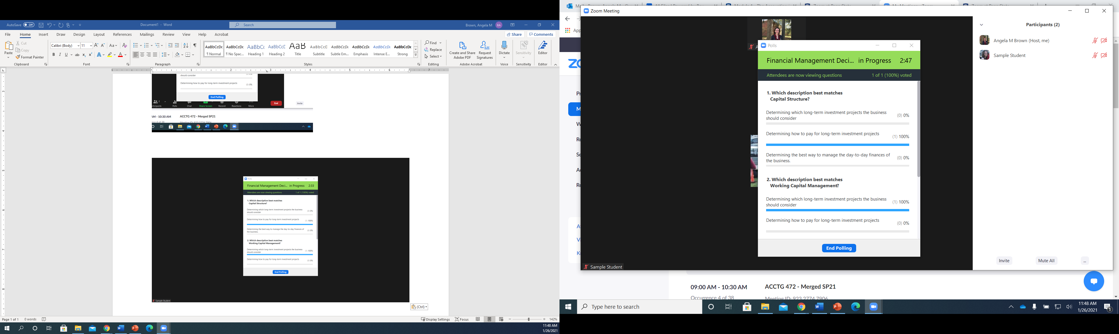
Polls - Execute
(4) End Poll
  During the poll, you can monitor:
    How long the poll has been active
    How many participants have submitted answers
    What answers are being submitted

Slide 8
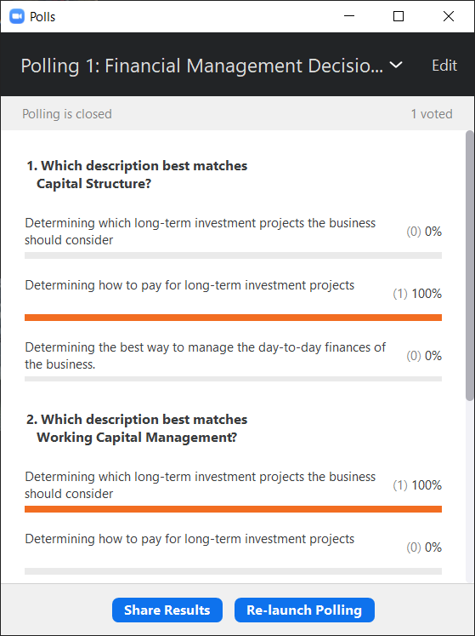
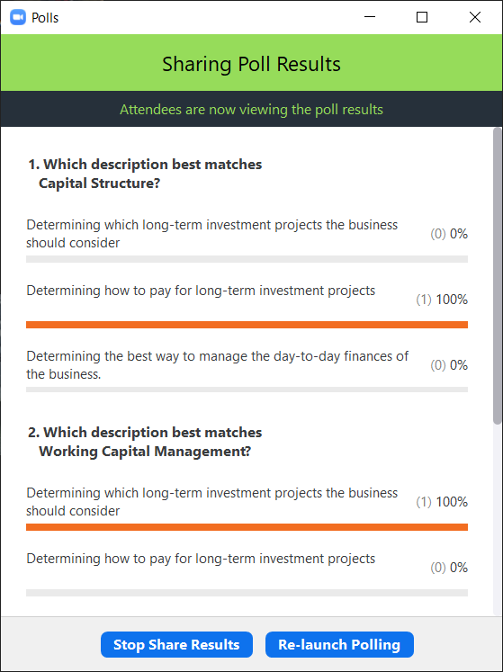
Polls - Execute
(5) Share results/ Re-launch Polling

Slide 9
Thank you!

